Slide 1

Determination of the Radon Reduction of the ES Carbon Trap
James Haiston and Richard Schnee
(South Dakota School of Mines and Technology)
Presentation for Group Meeting
Feb 7, 2023

Slide 2

Assigned Task
How much radon from the LN boil-off should make its way into the brass-wool traps during a large-chamber transfer, and might it be enough to cause a detectable background?
-Dr Richard Schnee

Slide 3
Outline
Determine the total radon concentration passing into the carbon trap (and potentially making it into the brass-wool trap) during the transfer
1a) Determine the volume of N2 used in the transfer
1b) Determine the radon concentration in this N2
2) Determine an upper limit on the fraction of radon that makes it through the carbon trap.
2a) Determine volume of N2 for pylon test
2b) Determine input activity for pylon test
2c) Determine upper limit on output activity for pylon test
3) Multiply together 1 and 2 to get an upper limit on the amount of radon that makes it into the brass-wool trap.

Slide 4
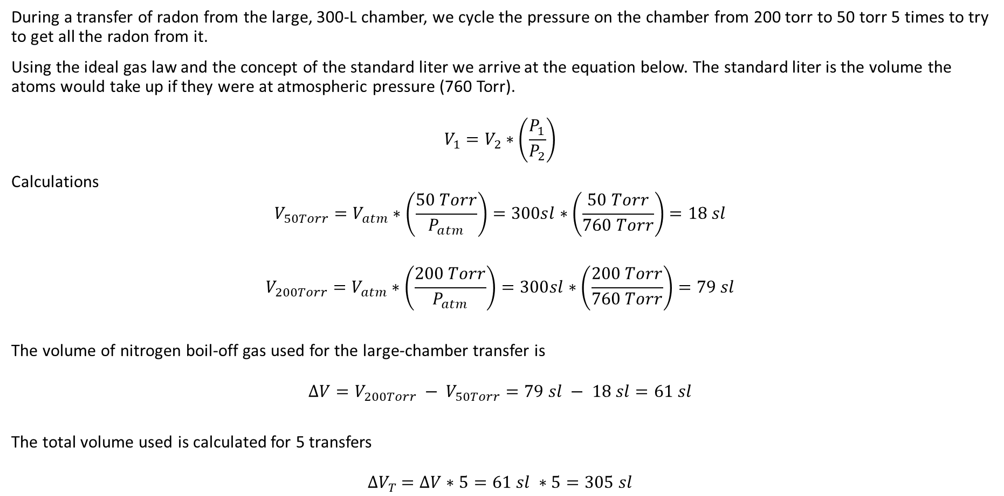
1a: Determine the volume of N2 Used in the Transfer
During a transfer of radon from the large, 300-L chamber, we cycle the pressure on the chamber from 200 torr to 50 torr 5 times to try to get all the radon from it.
Using the ideal gas law and the concept of the standard liter we arrive at the equation below. The standard liter is the volume the atoms would take up if they were at atmospheric pressure (760 Torr).
$$V_{1}=V_{2}∗\left(\frac{P_{1}}{P_{2}}\right)$$
Calculations
$$V_{50Torr}=V_{atm}∗\left(\frac{50 Torr}{P_{atm}}\right)=300sl∗\left(\frac{50 Torr}{760 Torr}\right)=18 sl$$
$$V_{200Torr}=V_{atm}∗\left(\frac{200 Torr}{P_{atm}}\right)=300sl∗\left(\frac{200 Torr}{760 Torr}\right)=79 sl$$
The volume of nitrogen boil-off gas used for the large-chamber transfer is
$$∆V=V_{200Torr} − V_{50Torr}=79 sl − 18 sl=61 sl$$
The total volume used is calculated for 5 transfers
$${∆V}_{T} =∆V∗5=61 sl ∗5=305 sl$$

Slide 5
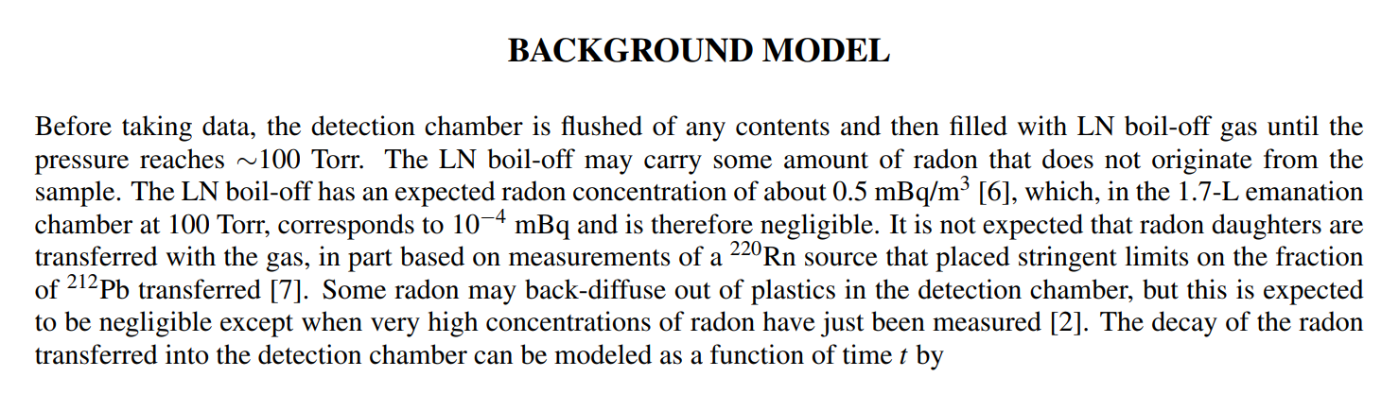
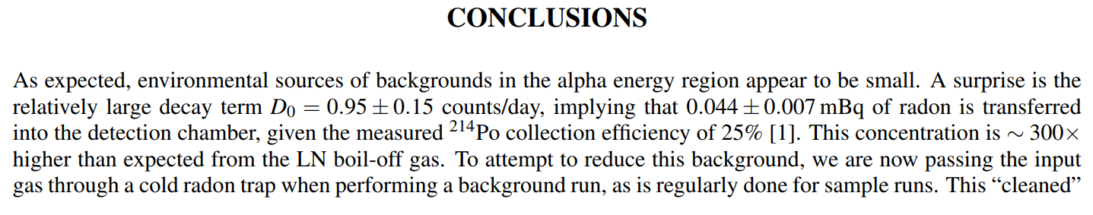
1b: Determine the Radon Concentration of N2 in Large Chamber Transfer
From the paper ‘Analysis of Backgrounds for a Radon-Emanation System’, S.I. Bendigo, N.I. Chott, R.W. Schnee, D.R. Tronstad, and K. Weber, written for LRT 2022, we are given the expected activity of N2 boil-off.
.

Slide 6

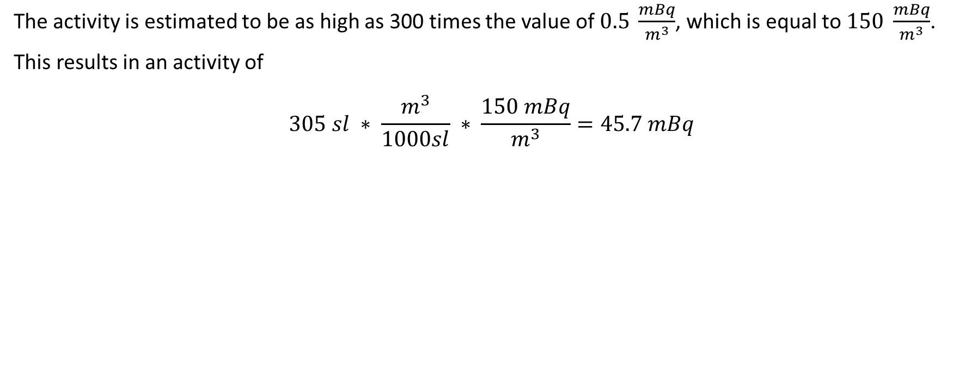
1b: Determine the Radon Concentration of N2 in Large Chamber Transfer
The activity is estimated to be as high as 300 times the value of $0.5 \frac{mBq}{m^{3}}$, which is equal to $150 \frac{mBq}{m^{3}}$.
This results in an activity of
$$305 sl ∗ \frac{m^{3}}{1000sl} ∗ \frac{150 mBq}{m^{3}}=45.7 mBq$$
And now a message from our sponsor.

Slide 7
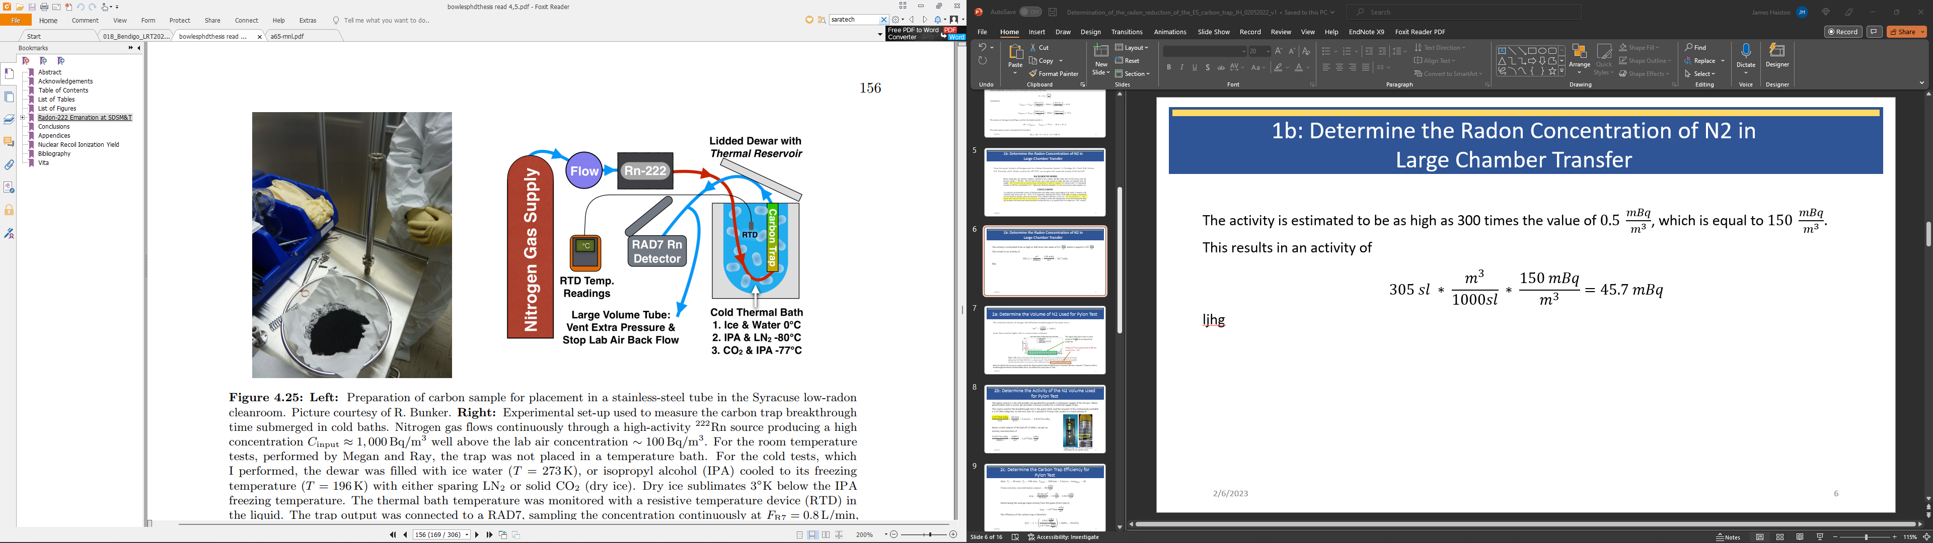
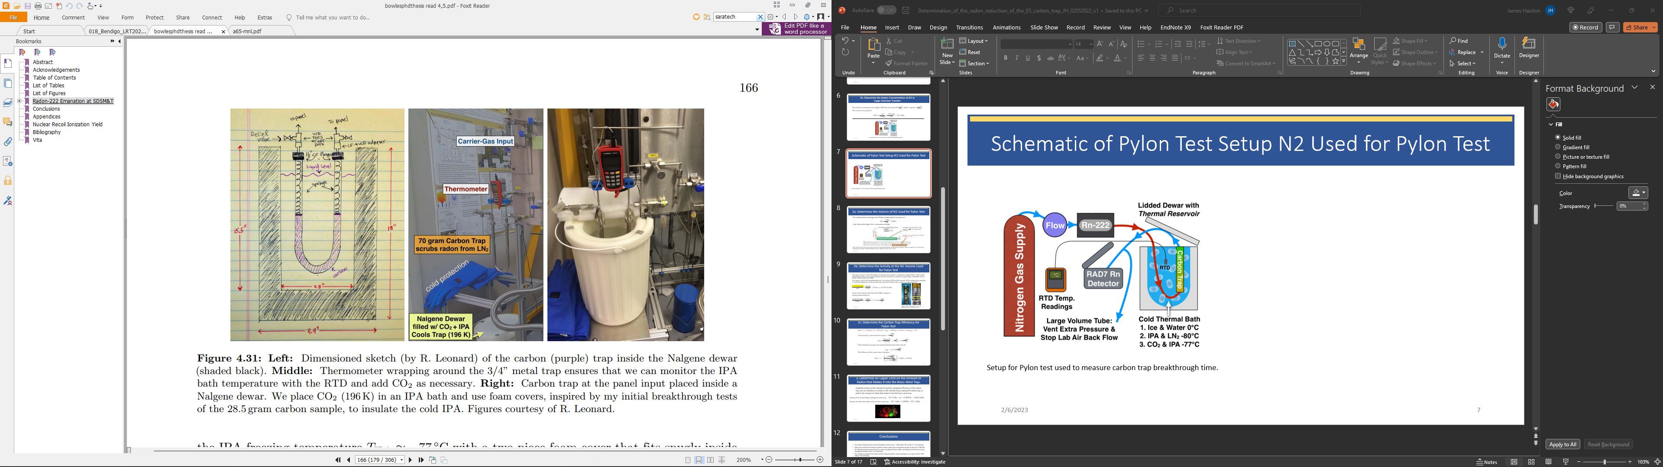
Schematic and Actual Test Setup Used for Pylon Test
Michael Bowles Thesis, Fig 4.25
Michael Bowles Thesis, Fig 4.31
Setup for Pylon test used to measure carbon trap breakthrough time.

Slide 8
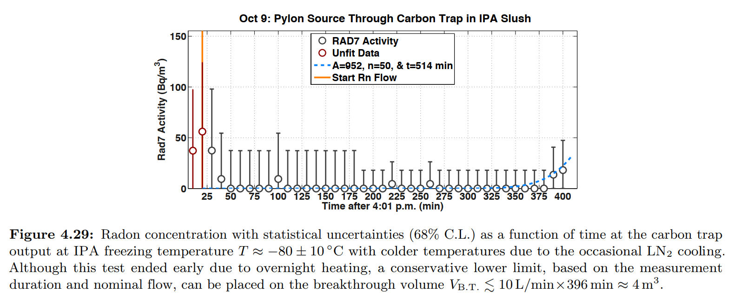
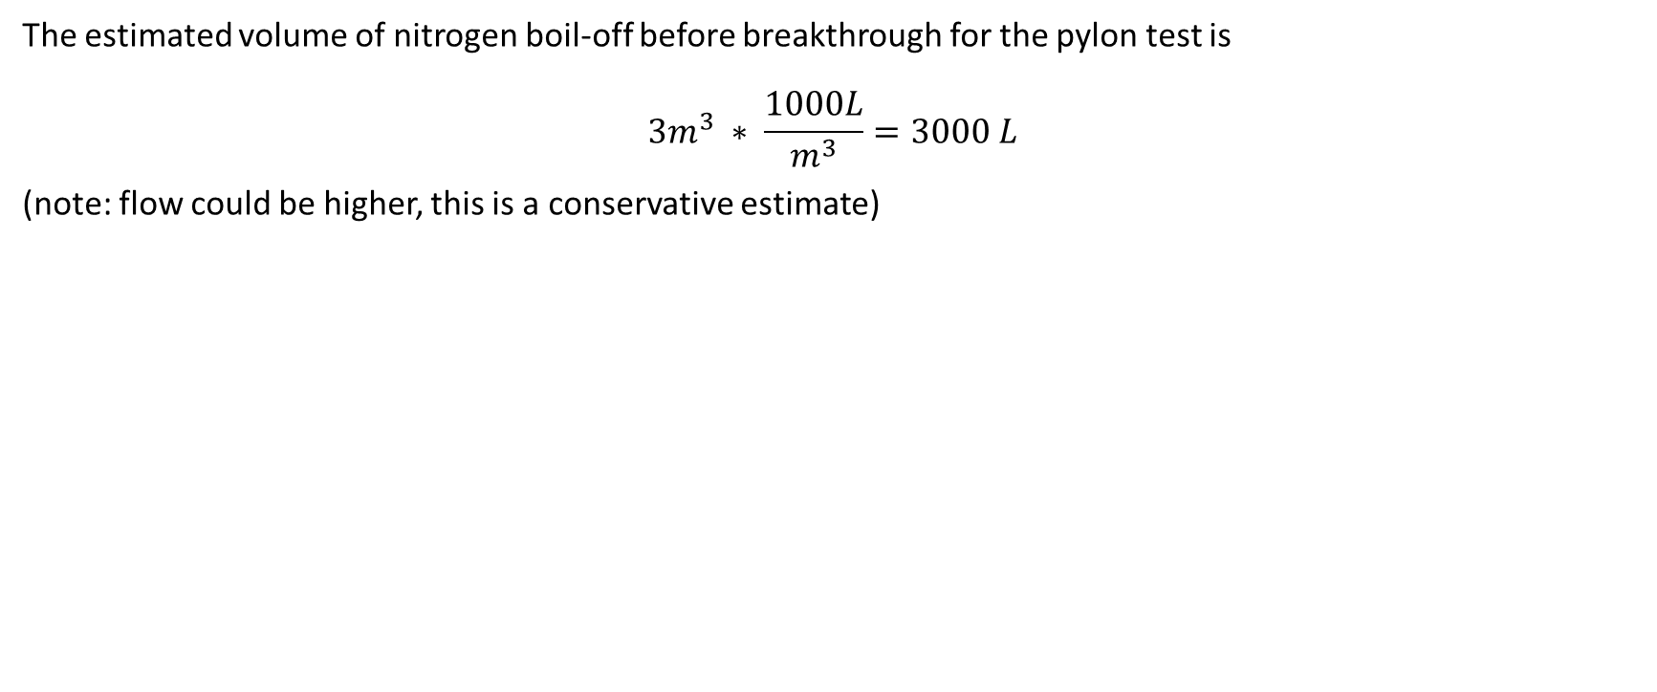
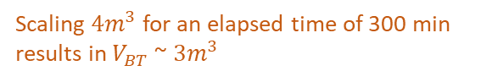
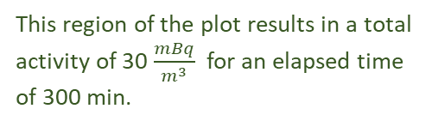
2a: Determine the Volume of N2 Used for Pylon Test
The estimated volume of nitrogen boil-off before breakthrough for the pylon test is
$$3m^{3} ∗ \frac{1000L}{m^{3}}=3000 L$$
(note: flow could be higher, this is a conservative estimate)
This region of the plot results in a total activity of 30 $\frac{mBq}{m^{3}}$ for an elapsed time of 300 min.
Scaling $4m^{3}$ for an elapsed time of 300 min results in$V_{BT}$ ~ $3m^{3}$
Note: the data for the test we are using is only for the 28 g trap which broke through because it warmed. We have a seperate 2.7-day test with no breakthrough described in Michael Bowles thesis, but without the output data vs. time.

Slide 9
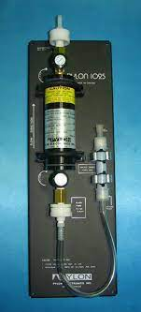
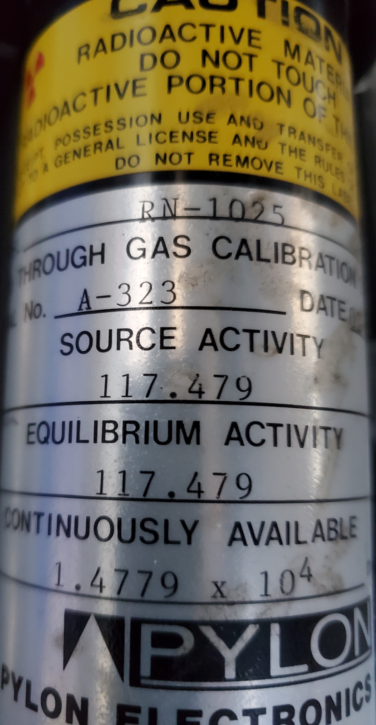
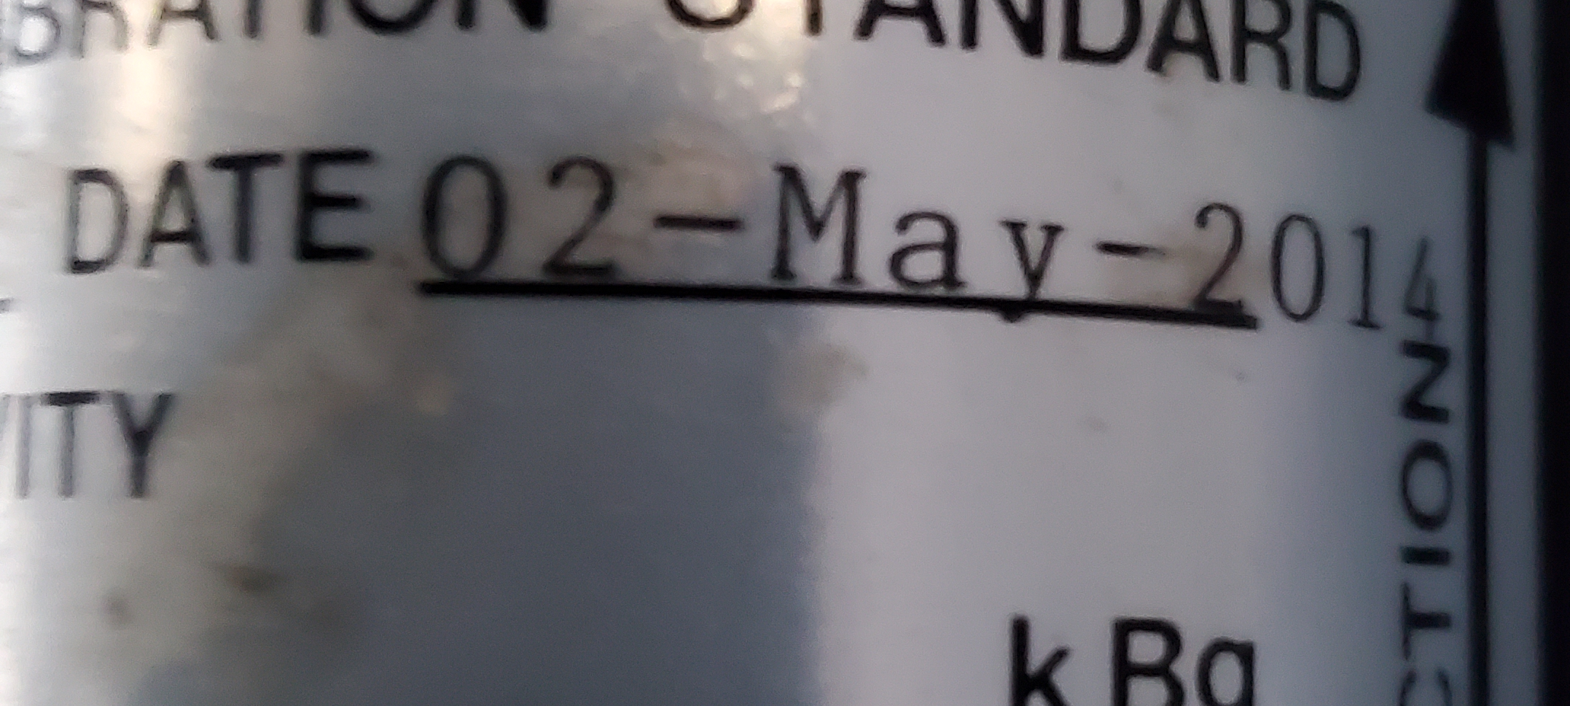
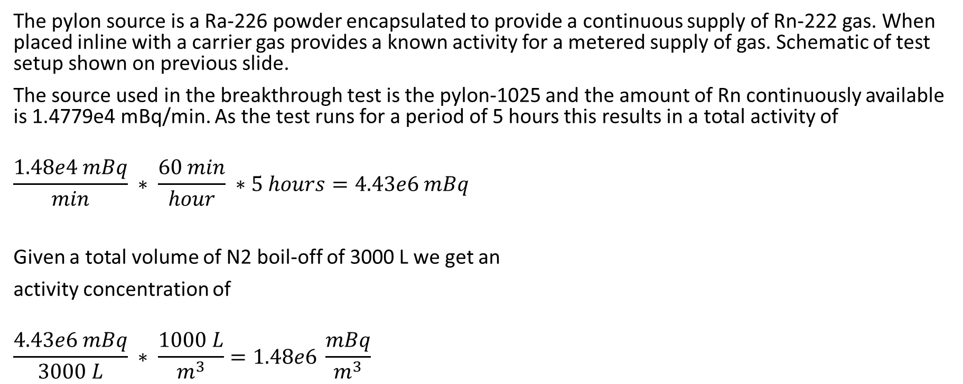
2b: Determine the Activity of the N2 Volume Used for Pylon Test
The pylon source is a Ra-226 powder encapsulated to provide a continuous supply of Rn-222 gas. When placed inline with a carrier gas provides a known activity for a metered supply of gas. Schematic of test setup shown on previous slide.
The source used in the breakthrough test is the pylon-1025 and the amount of Rn continuously available is 1.4779e4 mBq/min. As the test runs for a period of 5 hours this results in a total activity of
$$\frac{1.48e4 mBq}{min} ∗ \frac{60 min}{hour} ∗5 hours=4.43e6 mBq$$
Given a total volume of N2 boil-off of 3000 L we get an
activity concentration of
$$\frac{4.43e6 mBq}{3000 L} ∗ \frac{1000 L}{m^{3}}=1.48e6 \frac{mBq}{m^{3}}$$
Image of Pylon-1025 Rn-222 source and information for our specific source.

Slide 10
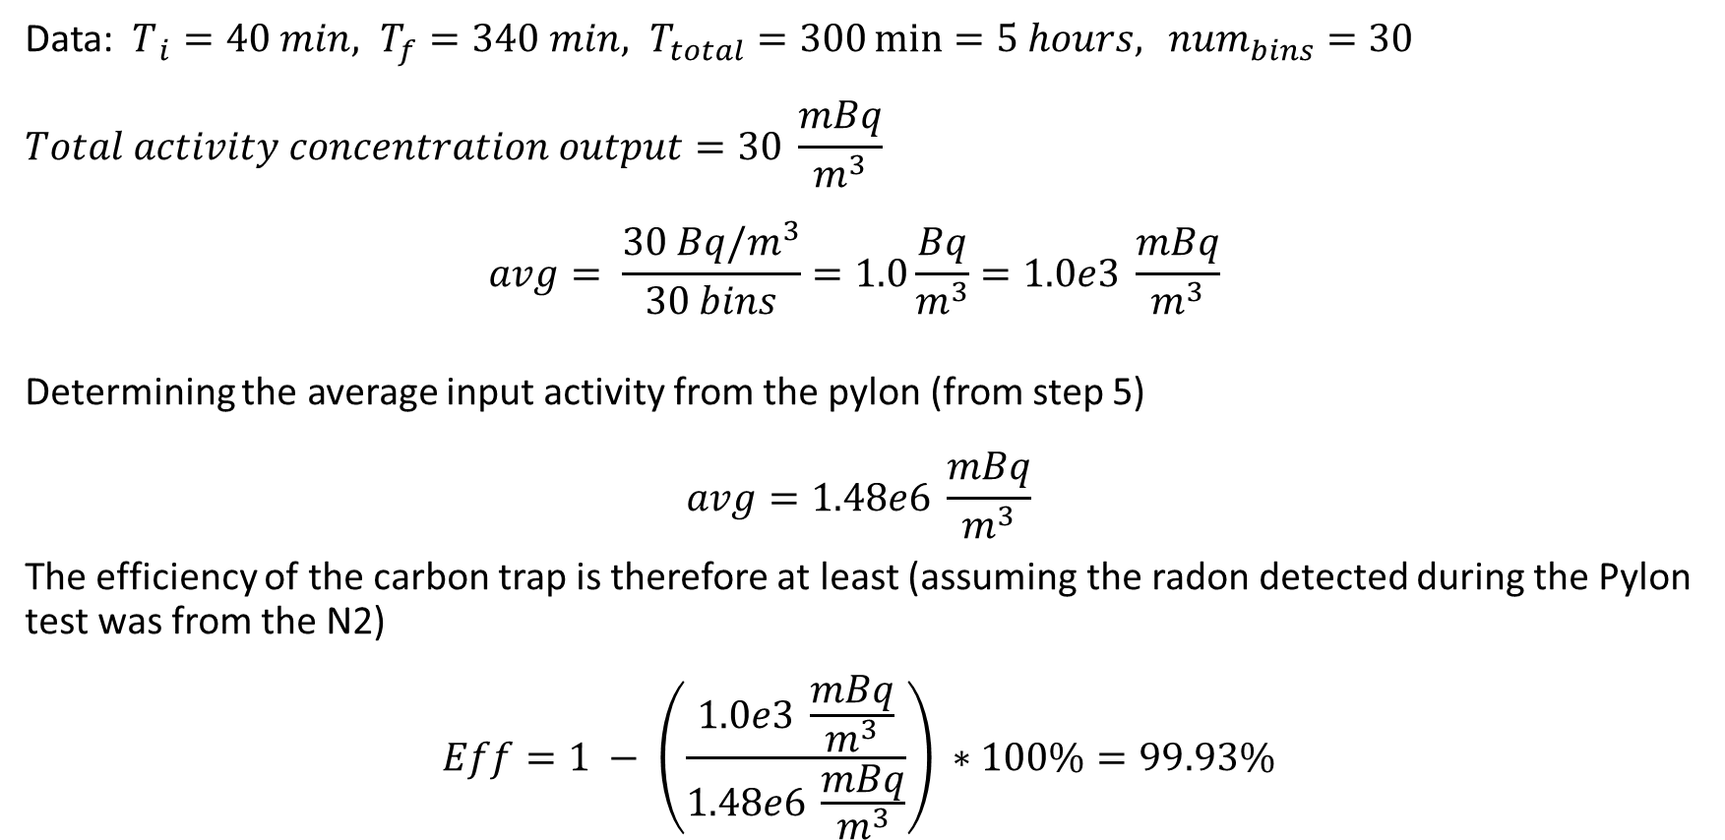
2c: Determine the Carbon Trap Efficiency for Pylon Test
Data: $T_{ i}=40 min, T_{f}=340 min, T_{total}=300\min{=5 hours,} {num}_{bins}=30$
$$Total activity concentration output=30 \frac{mBq}{m^{3}}$$
$$avg= \frac{30 Bq/m^{3}}{30 bins}=1.0\frac{Bq}{m^{3}}=1.0e3 \frac{mBq}{m^{3}}$$
Determining the average input activity from the pylon (from step 5)
$$avg=1.48e6 \frac{mBq}{m^{3}}$$
The efficiency of the carbon trap is therefore at least (assuming the radon detected during the Pylon test was from the N2)
$$Eff=1 − \left(\frac{1.0e3 \frac{mBq}{m^{3}}}{1.48e6 \frac{mBq}{m^{3}}}\right) ∗100\%=99.93\%$$

Slide 11
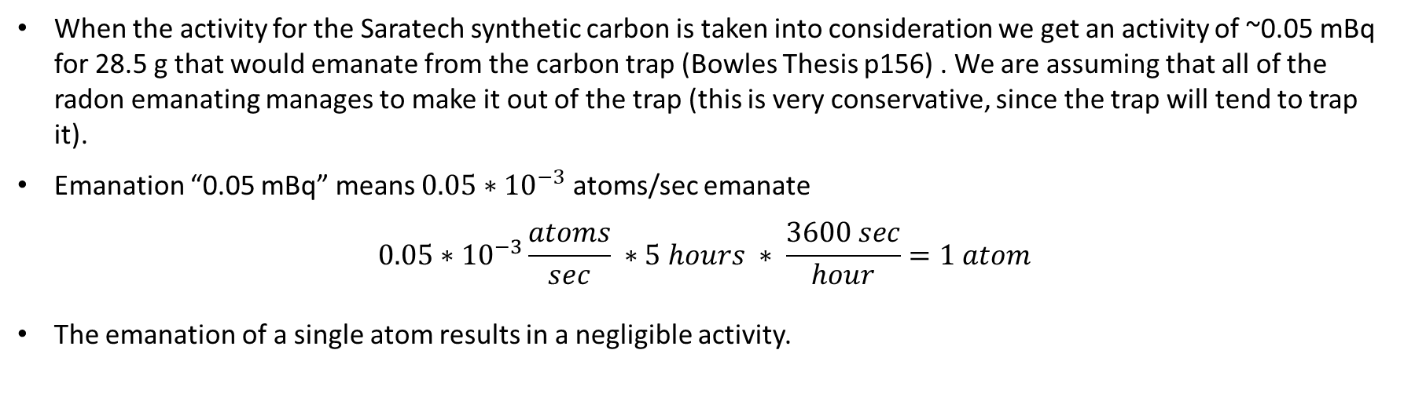
The Saratech Synthetic Carbon Emanation and Environmental Backgrounds Must be Taken Into Consideration
When the activity for the Saratech synthetic carbon is taken into consideration we get an activity of ~0.05 mBq for 28.5 g that would emanate from the carbon trap (Bowles Thesis p156) . We are assuming that all of the radon emanating manages to make it out of the trap (this is very conservative, since the trap will tend to trap it).
Emanation “0.05 mBq” means ${0.05∗10}^{−3}$ atoms/sec emanate
$$0.05∗{10}^{−3}\frac{atoms}{sec} ∗5 hours ∗ \frac{3600 sec}{hour}=1 atom$$
The emanation of a single atom results in a negligible activity.

Slide 12


3: Determine an Upper Limit on the Amount of Radon that Makes it into the Brass-Wool Trap.
Using the activity of the LN boil-off and the calculated efficiency of the carbon trap, we can calculate an activity of the LN boil-off gas exiting the carbon trap as well as the amount of radon that makes it into the brass-wool trap.
Activity of the LN boil-off gas exiting the carbon trap
$$45.7 mBq ∗\left(1 −0.9993\right)=0.032 mBq$$
Amount of radon that makes it into the brass-wool trap
$$\sim 0.032 mBq$$
The activity of N2 gas that has passed through the carbon trap is ~ $0.032 mBq$.
This results in 2.8 counts/day * 0.25 collection efficiency =~0.7 counts/day (at most; if the radon measured during the pylon test was not from breakthough, the background will be lower)
As the minimum limit for detection is 2 cpd and the N2 produces <0.07 cpd the efficiency of the carbon trap is reasonable.

Slide 13

Questions

